Slide 1
Data Structure and Algorithm CSE- 225
Dr. Mohammad Abu Yousuf
yousuf@juniv.edu

Slide 2
B-Tree
a B-tree is a self-balancing tree data structure that keeps data sorted and allows searches, sequential access, insertions, and deletions in logarithmic time.
The B-tree is a generalization of a binary search tree in that a node can have more than two children.
Unlike self-balancing binary search trees, the B-tree is optimized for systems that read and write large blocks of data. B-trees are a good example of a data structure for external memory. It is commonly used in databases and file systems.

Slide 3
The B-Tree Rules
Important properties of a B-tree:
B-tree nodes have many more than two children.
A B-tree node may contain more than just a single element.

Slide 4
The B-Tree Rules
The set formulation of the B-tree rules: Every B-tree depends on a positive constant integer called MINIMUM, which is used to determine how many elements are held in a single node.
Rule 1: The root can have as few as one element (or even no elements if it also has no children); every other node has at least MINIMUM elements.
Rule 2: The maximum number of elements in a node is twice the value of MINIMUM.
Rule 3: The elements of each B-tree node are stored in a partially filled array, sorted from the smallest element (at index 0) to the largest element (at the final used position of the array).

Slide 5
The B-Tree Rules
Rule 4: The number of subtrees below a non-leaf node is always one more than the number of elements in the node.
Subtree 0, subtree 1, ...
Rule 5: For any non-leaf node:
An element at index i is greater than all the elements in subtree number i of the node, and
An element at index i is less than all the elements in subtree number i + 1 of the node.
Rule 6: Every leaf in a B-tree has the same depth. Thus it ensures that a B-tree avoids the problem of a unbalanced tree.

Slide 6
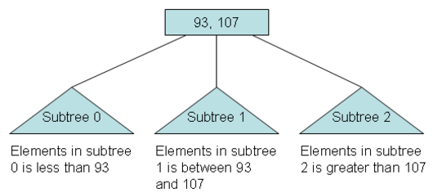
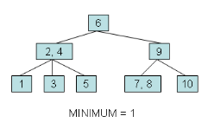
The B-Tree Rules

Slide 7
Searching for a Target in a Set
The psuedocode:
Make a local variable, i, equal to the first index such that data[i] >= target. If there is no such index, then set i equal to dataCount, indicating that none of the elements is greater than or equal to the target.
2. if (we found the target at data[i]) return true; else if (the root has no children) return false; else return subset[i].contains(target);

Slide 8
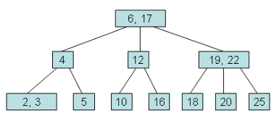
Searching for a Target in a Set
See the following example, try to search for 10.

Slide 9
Red-Black Trees
A red-black tree is a binary search tree with one extra bit of storage per node: its color, which can be either RED or BLACK.
By constraining the node colors on any simple path from the root to a leaf, red-black trees ensure that no such path is more than twice as long as any other, so that the tree is approximately balanced.

Slide 10
Red-Black Trees
Each node of the tree now contains the attributes color, key, left, right, and p.
If a child or the parent of a node does not exist, the corresponding pointer attribute of the node contains the value NIL.
We shall regard these NILs as being pointers to leaves (external nodes) of the binary search tree and the normal, key-bearing nodes as being internal nodes of the tree.

Slide 11
Red-Black Trees
A red-black tree is a binary tree that satisfies the following red-black properties:
1. Every node is either red or black.
2. The root is black.
3. Every leaf (NIL) is black.
4. If a node is red, then both its children are black.
5. For each node, all simple paths from the node to descendant leaves contain the same number of black nodes.

Slide 12
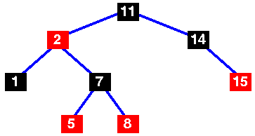
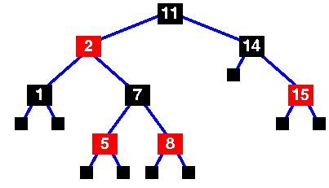
Red-Black Trees
A basic red-black tree
Basic red-black tree with the sentinel nodes added. Implementations of the red-black tree algorithms will usually include the sentinel nodes as a convenient means of flagging that you have reached a leaf node. They are the NULL black nodes of property 3.
The number of black nodes on any path from, but not including, a node x to a leaf is called the black-height of a node, denoted bh(x).

Slide 13
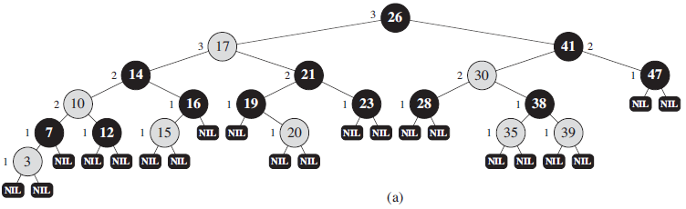
Red-Black Trees
An example of a red-black tree. Every leaf, shown as a NIL, is black. Each non-NIL node is marked with its black-height; NILs have black-height 0.

Slide 14
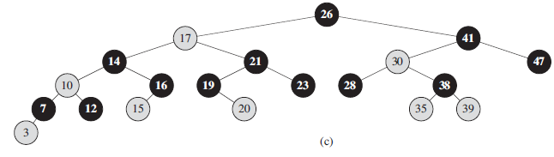
Red-Black Trees
The same red-black tree but with leaves and the root’s parent omitted entirely.

Slide 15
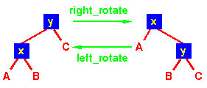
Rotations on red-black trees
As with heaps, additions and deletions from red-black trees destroy the red-black property, so we need to restore it. To do this we need to look at some operations on red-black trees.
A rotation is a local operation in a search tree that preserves in-order traversal key ordering. Note that in both trees, an in-order traversal yields:
A x B y C

Slide 16
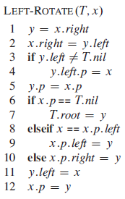
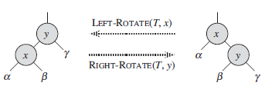
Rotations on red-black trees

Slide 17
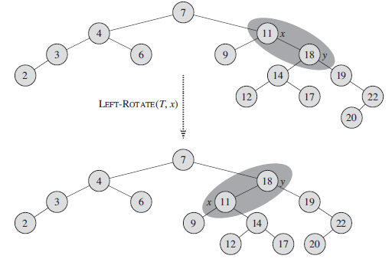
An example of how the procedure LEFT-ROTATE (T, x) modifies a binary search tree. Inorder tree walks of the input tree and the modified tree produce the same listing of key values.

Slide 18
Operations on red-black trees
We can implement the dynamic-set operations SEARCH, MINIMUM, MAXIMUM, SUCCESSOR, and PREDECESSOR in O(lgn) time on red-black trees, since each can run in O(h) time on a binary search tree of height h and any red-black tree on n nodes is a binary search tree with height O(lgn).

Slide 19
B+ tree
In the B+-tree, each node stores up to d references to children and up to d − 1 keys. Each reference is considered “between” two of the node's keys; it references the root of a subtree for which all values are between these two keys.

Slide 20
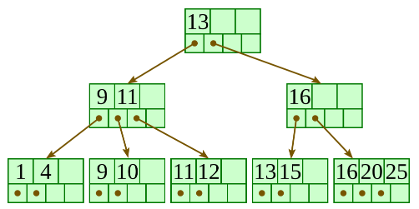
Here is a fairly small B+ tree using 4 as our value for d.
A B+-tree requires that each leaf be the same distance from the root, as in this picture, where searching for any of the 11 values (all listed on the bottom level) will involve loading three nodes from the disk (the root block, a second-level block, and a leaf).

Slide 21
A B+-tree maintains the following invariants:
Every node has one more references than it has keys.
All leaves are at the same distance from the root.
For every non-leaf node N with k being the number of keys in N: all keys in the first child's subtree are less than N's first key; and all keys in the ith child's subtree (2 ≤ i ≤ k) are between the (i − 1)th key of n and the ith key of n.
The root has at least two children.
Every non-leaf, non-root node has at least floor(d / 2) children.
Each leaf contains at least floor(d / 2) keys.
Every key from the table appears in a leaf, in left-to-right sorted order.

Slide 22
Thank you

